Slide 1




Networking Basics

Slide 2
“اللَّهُمَّ إِنِّي أَسْأَلُكَ عِلْمًا نَافِعًا، وَرِزْقًا طَيِّبًا، وَعَمَلًا مُتَقَبَّلًا”
"اے اللہ! مجھے نافع علم، پاکیزہ رزق اور مقبول عمل عطا فرما۔"

Slide 3
Recap: What is an Embedded System?
“Small computers built into devices to control their specific functions.”
Embedded systems are:
Unique in character and behavior
With specialized hardware and software
Computer Science Department, UET Lahore.

Slide 4
Recap: General-Purpose VS Embedded
General-Purpose (Computer) Systems | Embedded Systems
Variety of applications | Specific applications
has large memory, storage, and processors | uses minimal memory, processor, and energy
Changeable software | Fixed software
Desktop PCs, Laptops, Smartphones, Tablets | ATMs, Cars, Microwave ovens
Computer Science Department, UET Lahore.

Slide 5

Recap: Embedded Systems
“Do all embedded systems work alone or connected??”
Computer Science Department, UET Lahore.

Slide 6

Today’s Goal
“How all embedded systems connected together to share data and act intelligently?”
Computer Science Department, UET Lahore.

Slide 7
Today’s Goal
Smart devices often must report, coordinate, or be controlled, such as
Smart car sensors interact with traffic systems (signal priority, congestion data)
Bridge strain gauges interact with control center (alerts, maintenance)
Medical wearables interact with clinician dashboards (trends, alarms)
Computer Science Department, UET Lahore.

Slide 8
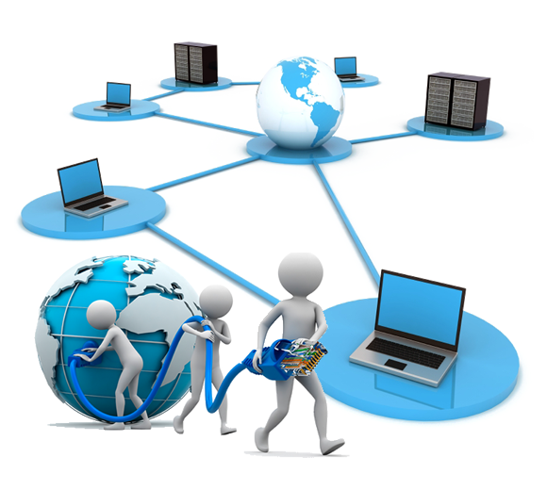
What is a Network?
“A network connects devices (nodes) so they can exchange data over links using protocols.”
Node (sensor, phone, server)
Link (wired/wireless)
Protocol (rules)
Computer Science Department, UET Lahore.

Slide 9
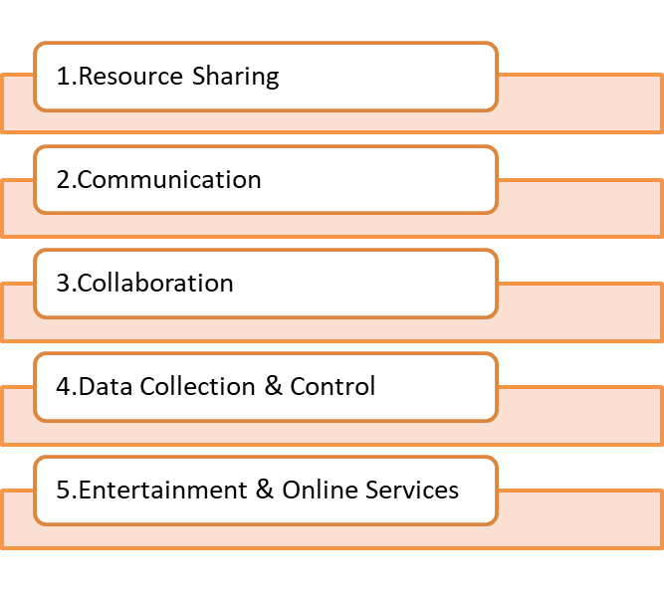
Why do we need networking?
Computer Science Department, UET Lahore.

Slide 10
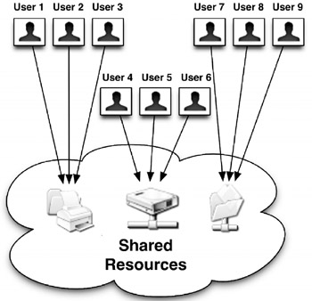
1. Resource Sharing
Sharing avoids duplication: one printer, file server, or software license can serve many users.
Examples
Office: shared printers
University: centralized learning-management systems and software labs
Benefits
Cost savings
Centralized backups
Easier maintenance
Computer Science Department, UET Lahore.

Slide 11

2. Communication
Networks enable email, chat, and video conferencing
Instant long-distance communication.
Examples
Business meetings over Zoom
Mobile messaging
Push notifications
Benefits
Speed
Asynchronous collaboration
Global reach
Computer Science Department, UET Lahore.

Slide 12
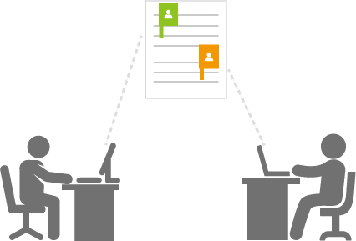
3. Collaboration
Multiple users can work on the same documents, codebases, or designs in real time.
Examples
Google Docs
Git repositories
Collaborative CAD tools
Benefits
Faster iteration
Version control
Distributed teams
Computer Science Department, UET Lahore.

Slide 13
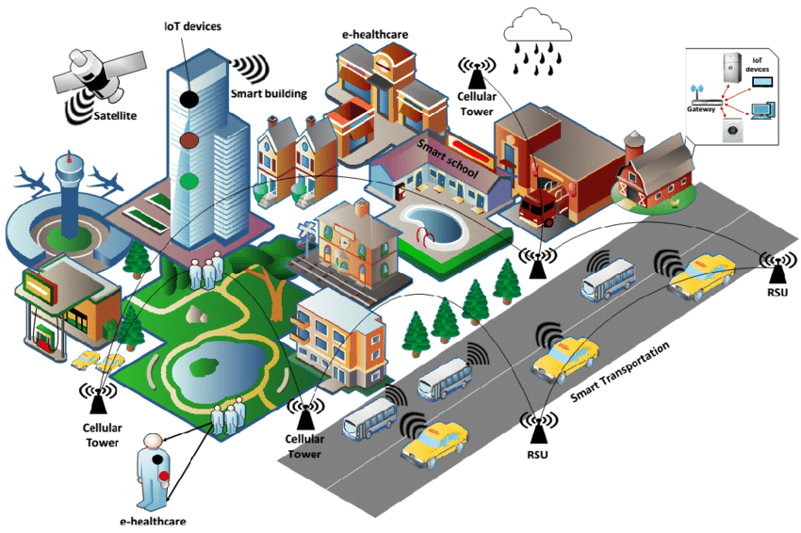
4. Data Collection and Control
Sensors collect environmental data and send it to central systems for analysis.
Examples
Weather stations
Traffic sensors
Health monitoring
Benefits
Centralized monitoring
Analytics
Predictive maintenance
Computer Science Department, UET Lahore.

Slide 14
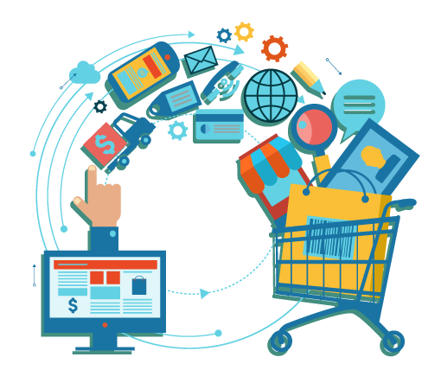
5. Entertainment & Online Services
Streaming, online gaming, and e-commerce rely on networks to deliver content and interactions.
Examples
Netflix
Multiplayer games
Online shopping platforms
Benefits
On‑demand content
Global marketplaces
Social platforms
Computer Science Department, UET Lahore.

Slide 15
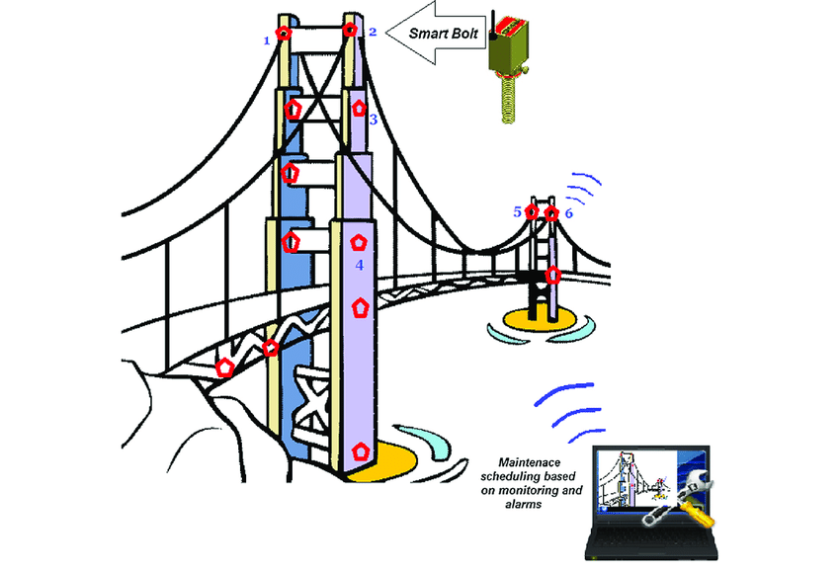
Role of networking in engineering
Embedded sensors on a bridge measure vibration, strain, and temperature.
Sensors send readings via a network to a control center where engineers analyze them.
Benefits
Enables remote
Continuous monitoring
Early detection of structural issues.
Computer Science Department, UET Lahore.
Notes:
Modern cars can host dozens of ECUs. Many tasks are time-bounded—brakes can’t ‘wait’.

Slide 16
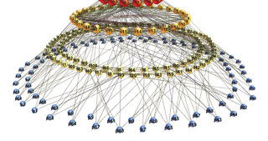
What is a network type?
Network types classify networks by geographic scope and purpose.
Different sizes imply different technologies, costs, and management models
Computer Science Department, UET Lahore.

Slide 17
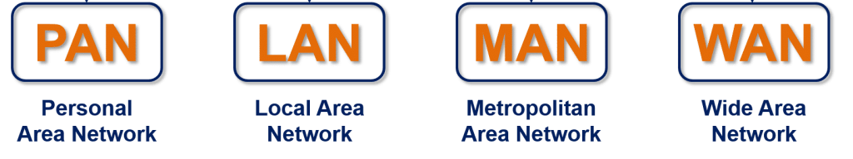
Types of Network
Computer Science Department, UET Lahore.
Notes:
Industrial loops need deterministic behavior—same response every time, on time.

Slide 18
Types of Network
Computer Science Department, UET Lahore.
Notes:
Industrial loops need deterministic behavior—same response every time, on time.

Slide 19
Types of Network
Computer Science Department, UET Lahore.
Notes:
Industrial loops need deterministic behavior—same response every time, on time.

Slide 20
Types of Network
Computer Science Department, UET Lahore.
Notes:
Industrial loops need deterministic behavior—same response every time, on time.

Slide 21
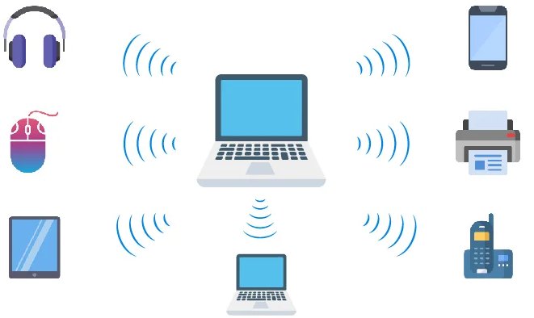
Types of Network: PAN
PAN (Personal Area Network)
Coverage: Usually within 10 meters (around one person)
Technology
Bluetooth Low Energy (BLE)
USB
Devices
Smartphone
Smartwatch
Wireless earphones
Design
Low power and low range
Computer Science Department, UET Lahore.
Notes:
Timing and reliability directly affect patient outcomes—designs prioritize fault detection and backups.

Slide 22
Types of Network
Computer Science Department, UET Lahore.
Notes:
Industrial loops need deterministic behavior—same response every time, on time.

Slide 23
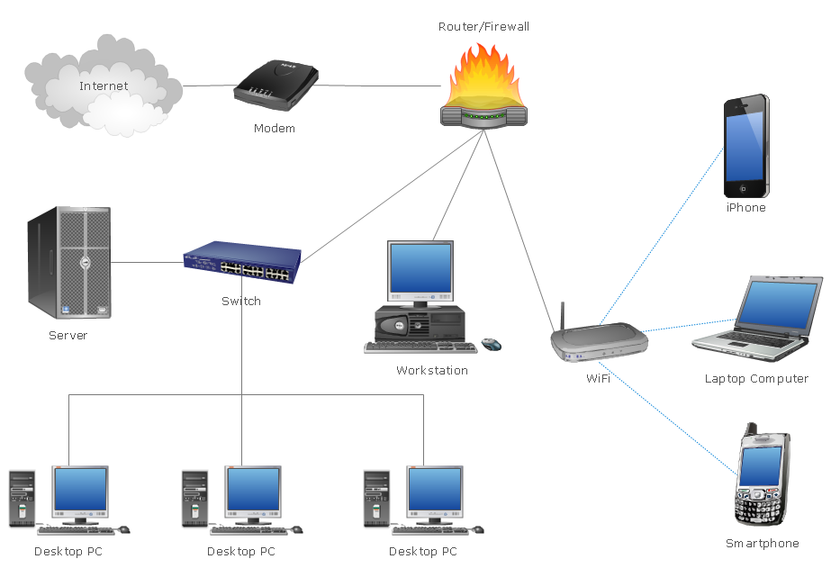
Types of Network: LAN
LAN (Local Area Network)
Coverage: Room, building, campus (tens to hundreds of meters)
Technology
Ethernet
Wi‑Fi
Devices
PCs
Printers
Office Wi‑Fi
Design
High bandwidth, supports many clients.
Computer Science Department, UET Lahore.

Slide 24
Types of Network
Computer Science Department, UET Lahore.
Notes:
Industrial loops need deterministic behavior—same response every time, on time.

Slide 25
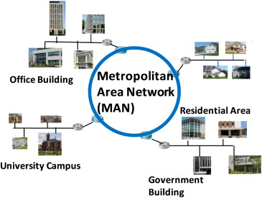
Types of Network: MAN
MAN (Metropolitan Area Network)
Coverage: City or metropolitan area (several kilometers to tens of kilometers)
Technology
Metro Ethernet
Municipal Wi‑Fi
Devices
City sensors gateways
Business campus interconnects
Design
Higher infrastructure cost than LAN
Computer Science Department, UET Lahore.

Slide 26
Types of Network
Computer Science Department, UET Lahore.
Notes:
Industrial loops need deterministic behavior—same response every time, on time.

Slide 27
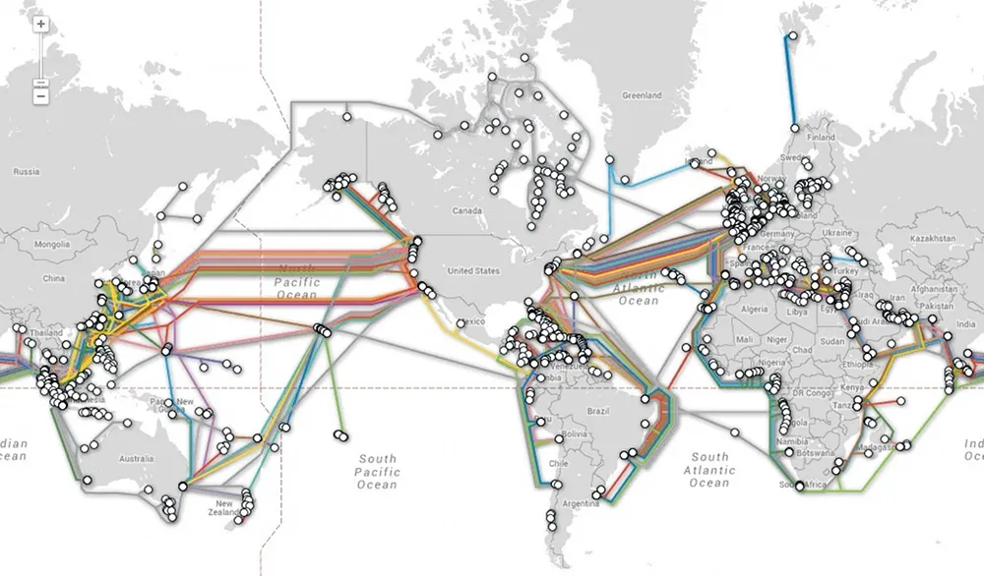
Types of Network: WAN
WAN (Wide Area Network)
Coverage: Regions, countries, global
Technology
Leased lines
Satellite links
Devices
Routers
Global links
Design
Large bandwidth aggregation and complex routing
Computer Science Department, UET Lahore.

Slide 28
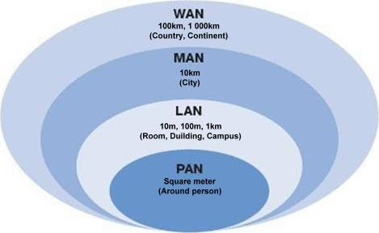
Types of Network
Computer Science Department, UET Lahore.

Slide 29
Review:
The smartwatch syncs to the phone, and the phone uploads health data to the cloud.
(PAN + LAN/WAN)
Two university campuses 10 km apart sharing resources.
(LANs connected by MAN)
A multinational company with offices in three countries.
(WAN)
Computer Science Department, UET Lahore.

Slide 30

Network Communication
“Do you know how these networks actually communicate?
Computer Science Department, UET Lahore.

Slide 31
OSI 7‑Layer Model
OSI model (Open Systems Interconnection model)
It is a conceptual framework with 7 layers that explain how data moves across networks.
Computer Science Department, UET Lahore.

Slide 32
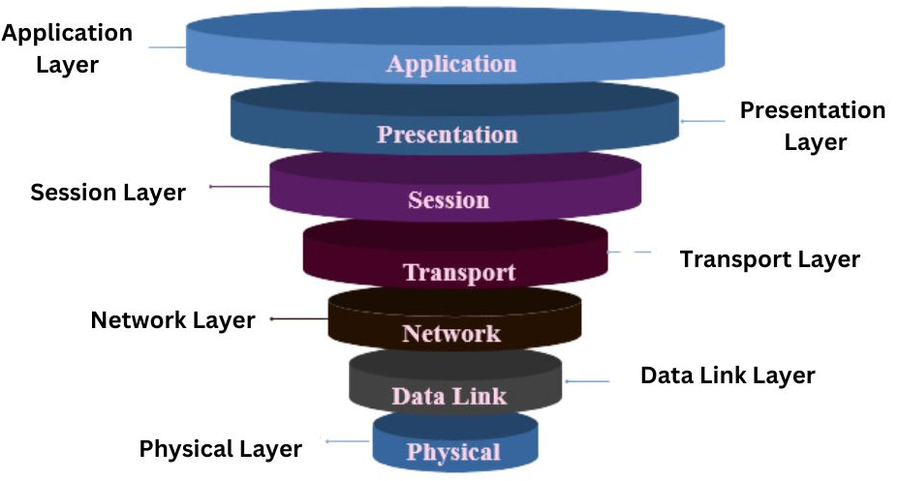
OSI 7‑Layer Model
Computer Science Department, UET Lahore.

Slide 33
OSI 7‑Layer Model
Computer Science Department, UET Lahore.

Slide 34
OSI 7‑Layer Model
Computer Science Department, UET Lahore.

Slide 35
OSI 7‑Layer Model
Computer Science Department, UET Lahore.

Slide 36
OSI 7‑Layer Model
Computer Science Department, UET Lahore.

Slide 37
OSI 7‑Layer Model
Computer Science Department, UET Lahore.

Slide 38
OSI 7‑Layer Model
Computer Science Department, UET Lahore.

Slide 39
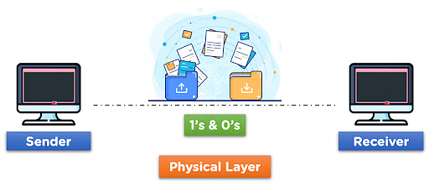
OSI Model: Physical Layer
Role: Move raw bits via electrical/Radio signals
Examples
Ethernet cabling
Fiber
Connectors
Devices
Hubs
Repeaters
Cables
Computer Science Department, UET Lahore.

Slide 40
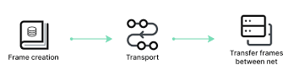
OSI Model: Data Link Layer
Role: Local delivery on the same network segment using frames
Key concepts:
MAC addresses
Error detection
Switching
Devices
Switches
Protocols
Ethernet
Wi‑Fi
Focus on neighbor‑to‑neighbor reliability.
Computer Science Department, UET Lahore.

Slide 41
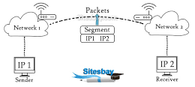
OSI Model: Network Layer
Role: End‑to‑end packet delivery across multiple networks
Key concepts
IP addressing
Gateways
Devices
Routers
Protocols
IPv4/IPv6
City‑to‑city routing using ZIP/post codes; choosing the best route
Computer Science Department, UET Lahore.

Slide 42
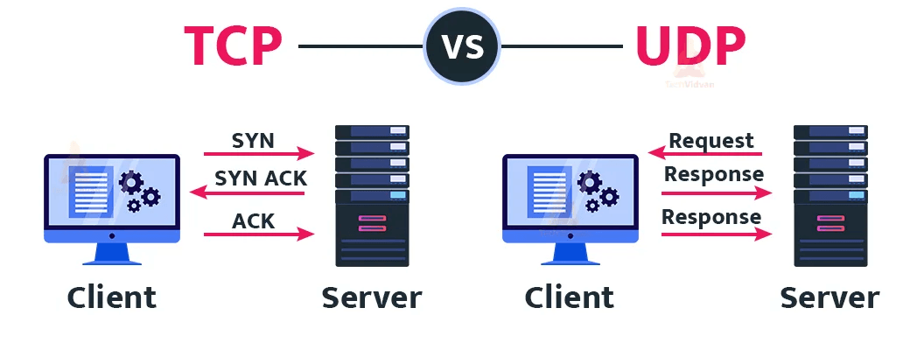
OSI Model: Transport Layer
Role: Process‑to‑process delivery, flow & error control Protocols
Transmission Control Protocol (TCP)
User Datagram Protocol (UDP)
Data unit
Segments (TCP) / Datagrams (UDP)
Use TCP for accuracy
And UDP for speed.
Computer Science Department, UET Lahore.

Slide 43
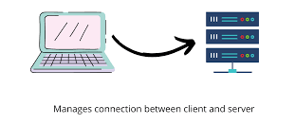
OSI Model: Session Layer
Role: Manage sessions, including start, maintain, and end dialogs
Examples
Managing a long video call
Remote procedure sessions
Ongoing conversation tracking, keeping the channel open
Computer Science Department, UET Lahore.

Slide 44
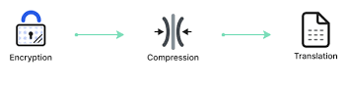
OSI Model: Presentation Layer
Role: Translate, compress, and encrypt data so applications can use it.
Examples
JPEG/PNG formats
JSON encoding
Character sets (UTF‑8)
Translating the letter’s language or sealing it in a locked envelope.
Computer Science Department, UET Lahore.

Slide 45
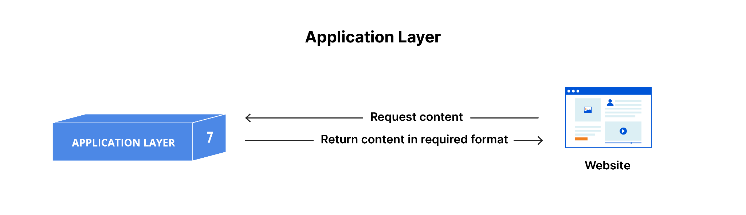
OSI Model: Application Layer
Role: Interfaces for users & apps to access network services
Examples
HTTP/HTTPS
SMTP/IMAP
WhatsApp clients
Web browsers
The letter you read and the application (email client) composing it.
Computer Science Department, UET Lahore.

Slide 46
Future of Networks
“Networks are the backbone of future systems, as they enable new capabilities such as real‑time control, sensing, and global reach.”
Examples
Self‑driving cars
Tele‑surgery
Smart grids
Satellites delivering
Computer Science Department, UET Lahore.

Slide 47
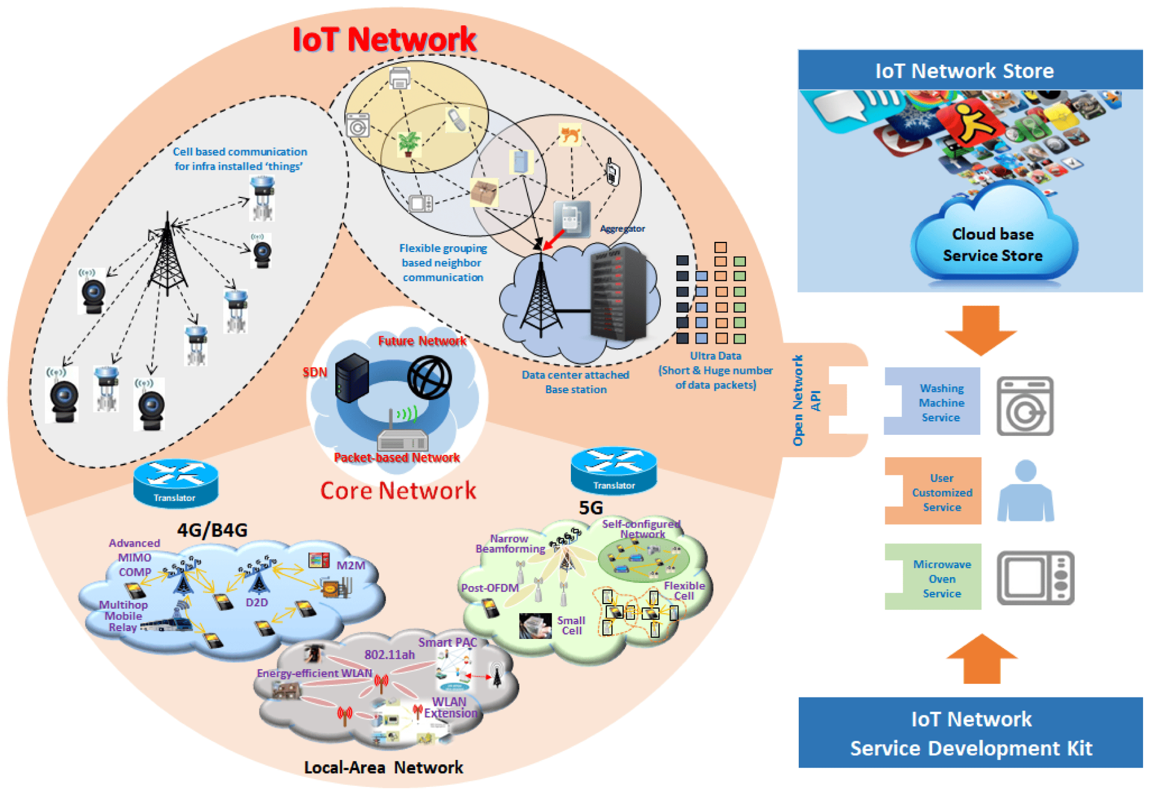
Future of Networks: IoT
“Billions of sensors and devices measuring, actuating, and automating in every sector.”
Examples
Wearables
Industrial sensors
Environmental monitors
Actuators/robots
Computer Science Department, UET Lahore.

Slide 48
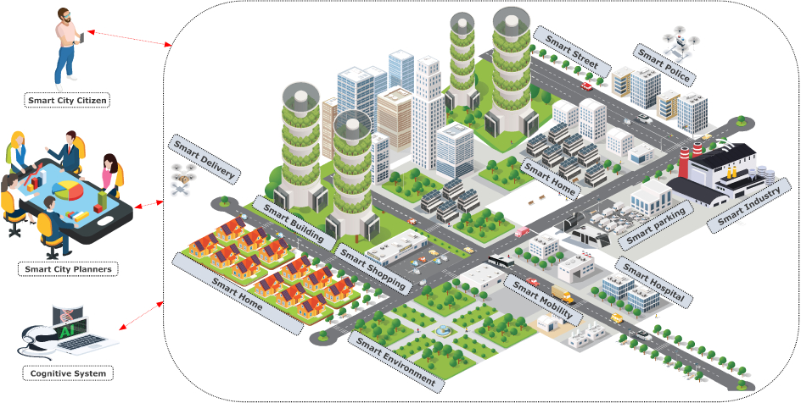
Future of Networks: Smart Cities
“Billions of sensors and devices measuring, actuating, and automating in every sector.”
Examples
Wearables
Industrial sensors
Environmental monitors
Actuators/robots
Computer Science Department, UET Lahore.

Slide 49
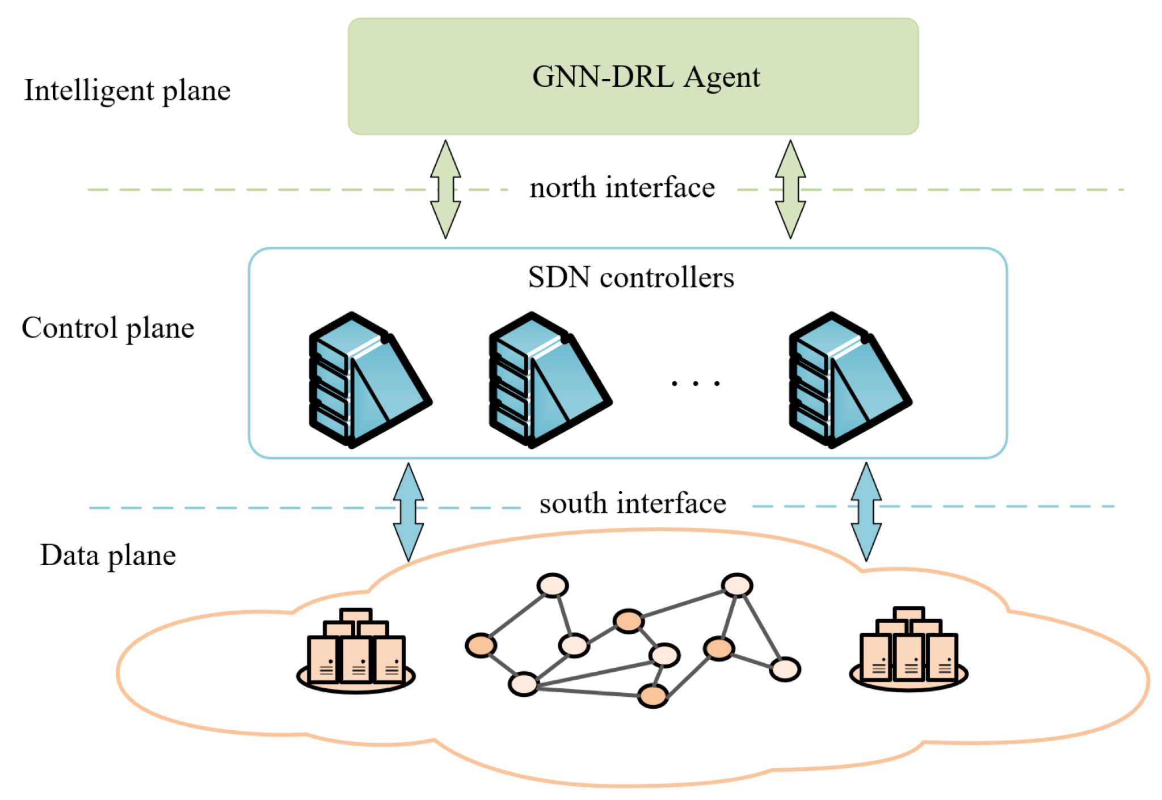
Future of Networks: AI‑Powered
“Networks that use ML to optimize routing, detect anomalies, predict failures, and self‑heal.”
Examples
Adaptive routing
Predictive alerts
Anomaly detection for security
Advantages
Improved efficiency
Reduced manual operations
Computer Science Department, UET Lahore.

Slide 50

Learning Objective
In this lecture, we learned the basics of networking, their needs, the role of networking in engineering, network types, the OSI model, and the future of networking.
Computer Science Department, UET Lahore.

Slide 51

Conclusion
Networks are the backbone of ICT, connecting people, devices, and systems.
Types like PAN, LAN, MAN, and WAN are the foundation of connectivity.
The OSI model explains 7 layers.
The future of networks is IoT, smart cities, and AI-driven systems.
For engineers, networking enables collaboration, monitoring, and automation.
Computer Science Department, UET Lahore.

Slide 52
“Networking is the digital glue that connects engineers, devices, and ideas across the world.”
Motivation

Slide 53

Self Assessment Tasks
1. True/False:
The OSI model has 5 layers. (T/F)
5G and IoT are future trends in networking. (T/F)
Networking has no role in automation for engineers. (T/F)
PAN usually connects personal devices like phones and wearables. (T/F)
LAN is smaller in area than WAN. (T/F)
Computer Science Department, UET Lahore.

Slide 54
Images from https://www.pngegg.com
GIFs courtesy of https://giphy.com
Pictures and Gifs Credits

